Slide 1
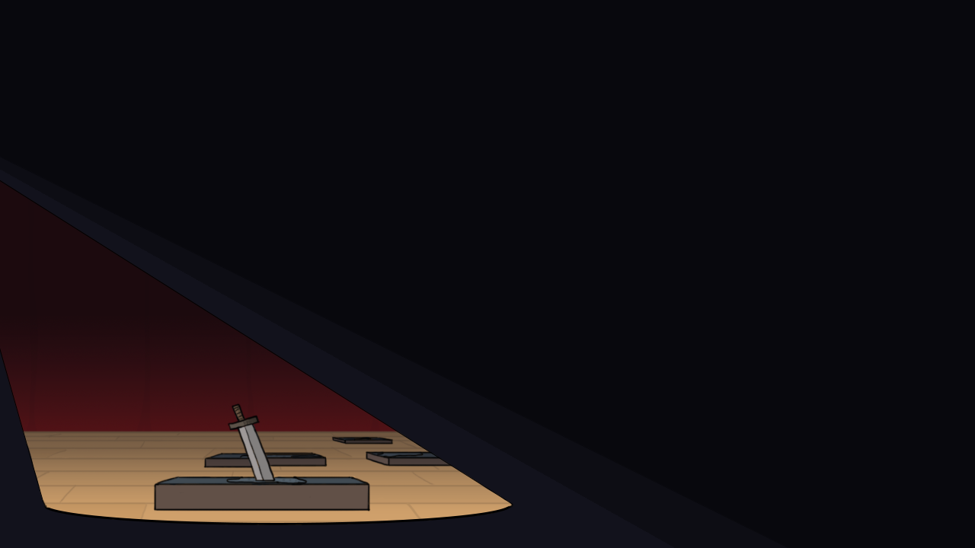

Nav Bhatti, Alex Kabak,
Chris Klassen, René Ye

Slide 2
Refresher
A game focused on minigame-driven JRPG combat
Move from arena to arena, defeating enemies

Slide 3
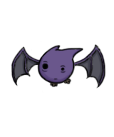
Alpha Feedback
Very positive
Some complaints:
More variety
Better UI
Cohesiveness between the two halves
Worries of stagnation
How we addressed these complaints:
More minigames
Cleaner UI and battle layout
Consistent art style
Difficulty progression

Slide 4
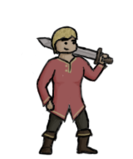
Challenges
Balancing the project with other classes and assignments
Complexity of the game’s systems
Finding time for proper testing

Slide 5
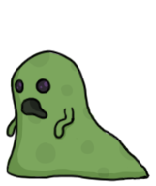
Current State
Other school work caused delays
Schedule became less valuable
Most beta plans completed
Art completed and integrated
Battle systems completed
Arena systems completed
Saving and loading
Polish
Some missed elements
Audio implementation
Story implementation

Slide 6
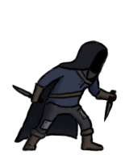
Testing
18 confirmed testers
8 testing sessions completed
Feedback positive
General response was an interest in seeing the game close to completion
Without proper balancing, it was hard to test the game itself

Slide 7

Plans for the Future
Completion of remaining content
Most remaining content is simple to implement
Addition of music and sound effects
Additional UI polish
General polish and testing

Slide 8
Demo

